Slide 1
JavaScript / ECMAScript
ECMAScript (ES) was developed by ECMA (European Computer Manufacturers Association)International after the organization adopted JavaScript.
The first edition of ECMAScript was released in 1997.
The ES standard version is often updated to include new features.
Versions of ES and the release year include: -
-ES5 in 2009 or ECMAScript 2009
▪ES6 in 2015
▪ES7 in 2016
▪ES8 in 2017
▪ES9 in 2018

Slide 2
Async in JavaScript -
In the browser, JavaScript is single-threaded, so only one task can run at a time.
•If tasks are run synchronously, the UI is blocked and the website becomes unresponsive.
•JavaScript I/O functions (write to disk and network calls) are non-blocking because they run asynchronously.
•There are three common patterns to consume asynchronous functions in JavaScript:
▪Callbacks
▪Promises
▪Async/await
These common patterns allow asynchronous functions to run in a deterministic manner.

Slide 3
Callbacks -
A callback function is passed as an argument into another function, which is invoked inside the other function to complete an action.
•A callback is a language feature of ES5 (2009).
Example –
function done()
{
console.log('Begin messing things up again');
}
function cleanRoom(listOfTasks, doneCallback)
{
for(let i = 0; i<listOfTasks.length; i++)
{
console.log(listOfTasks[i]);
}
doneCallback();
}
cleanRoom(['1. Collect things off the floor', '2. Bin Trash'], done);
O/p_ -
Collect things off the floor
Bin Trash
Begin messing things up again

Slide 4
The code example shows the function cleanRoom receiving an array of strings as the first argument and a function as the second argument. The cleanRoom function returns only after the done function returns.
The callback signature convention -
Callbacks are simple to use and are supported widely across browsers.
•The Node.js community uses an error-first callback signature, which means the following:
▪The first argument of a callback is reserved for an error object.
▪The second argument of a callback is reserved for any valid response data.

Slide 5
Callback hell -
Nesting callbacks within one another can lead to callback hell.
•Callback hell is required in cases where you want to ensure a specific sequence.
•Callback hell, also known as the Pyramid of Doom, is an anti-pattern that makes code hard to read and debug.

Slide 6
function logAfterDelay(message, cb) {
setTimeout(function()
{
console.log(message);
cb();
}, 500)
}
logAfterDelay('walk to the fish pond', function(){
logAfterDelay('Feed the fish', function(){
logAfterDelay('Match fish eat their food', function(){
logAfterDelay('Stand there and do nothing', function(){
});
});
});
});
O/P –
walk to the fish pond
Feed the fish
Match fish eat their food
Stand there and do nothing

Slide 7
The example shows the logAfterDelay function, which receives a string of “Walk to the fish pond” as the first argument and a new instance of the logAfterDelay function as the second argument. As the number of nested functions grows, the code becomes harder to read.
The programmer is faced with the challenge of splitting code into separate functions to obey the single responsibility principle and for reusability, and balancing these items against the readability of the code.

Slide 8
JavaScript: Learn Promises

Slide 9
Why do we need Promises?
Promises (like callbacks) allow us to wait on certain code to finish execution prior to running the next bit of code.
Why is this important? Think about a website that loads data from an API then processes and formats the data to display to the user. If we try to process and format our data before the API has even fetched the information, we’re either going to get an error or a blank website. By using a Promise, we can ensure that the API data isn’t processed/formatted until after our API call has succeeded.

Slide 10
The constructor syntax for a promise object is:-
let promise = new Promise(function(resolve, reject) {
// executor (success , error)
});
The function passed to new Promise is called the executor. When the promise is created, this executor function runs automatically. It contains functions that runs depending upon whether a promise is successful or not.

Slide 11
The resulting promise object has internal properties:
state — initially “pending”, then changes to either “fulfilled” or “rejected”,
result — an arbitrary value, initially undefined.
When the executor finishes the job, it should call one of the functions that it gets as arguments:
resolve(value) — to indicate that the job finished successfully:
sets state to "fulfilled",
sets result to value.
reject(error) — to indicate that an error occurred:
sets state to "rejected",
sets result to error.

Slide 12
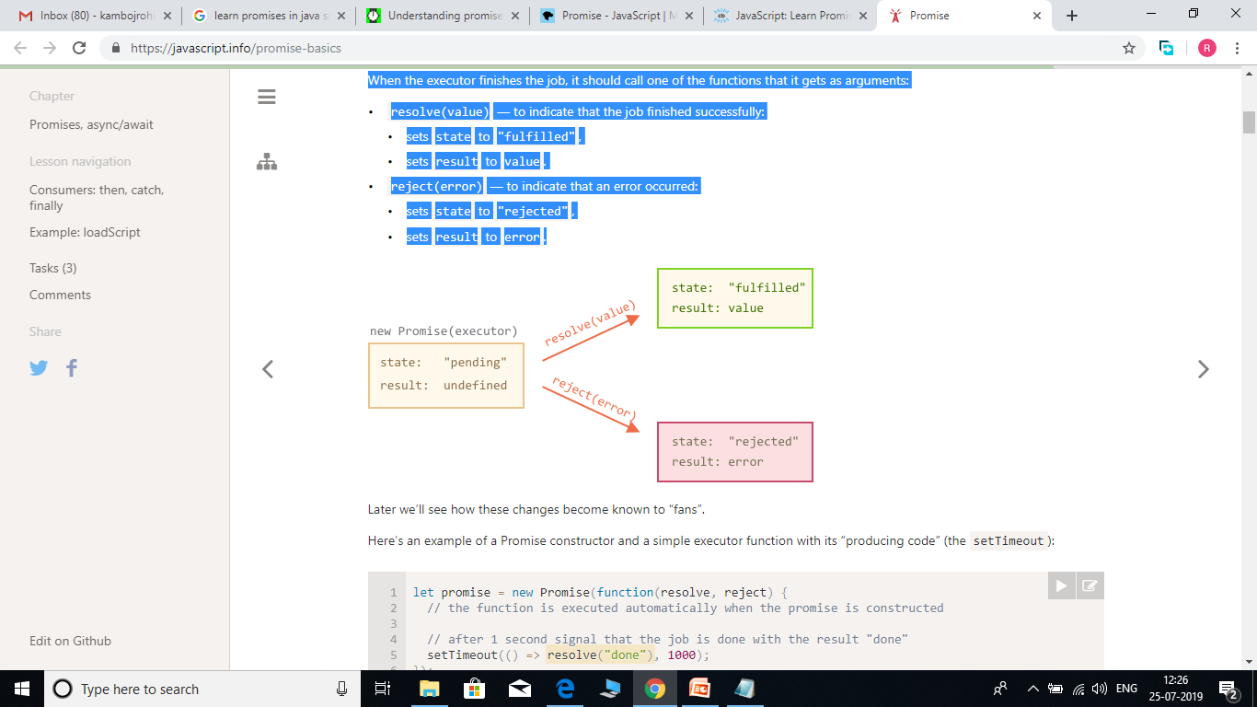
Here’s an example of a Promise constructor and a simple executor function with its “producing code” (the setTimeout):
let promise = new Promise(function(resolve, reject) {
// the function is executed automatically when the promise is constructed
// after 1 second signal that the job is done with the result "done"
setTimeout(() => resolve("done"), 1000);
});

Slide 13
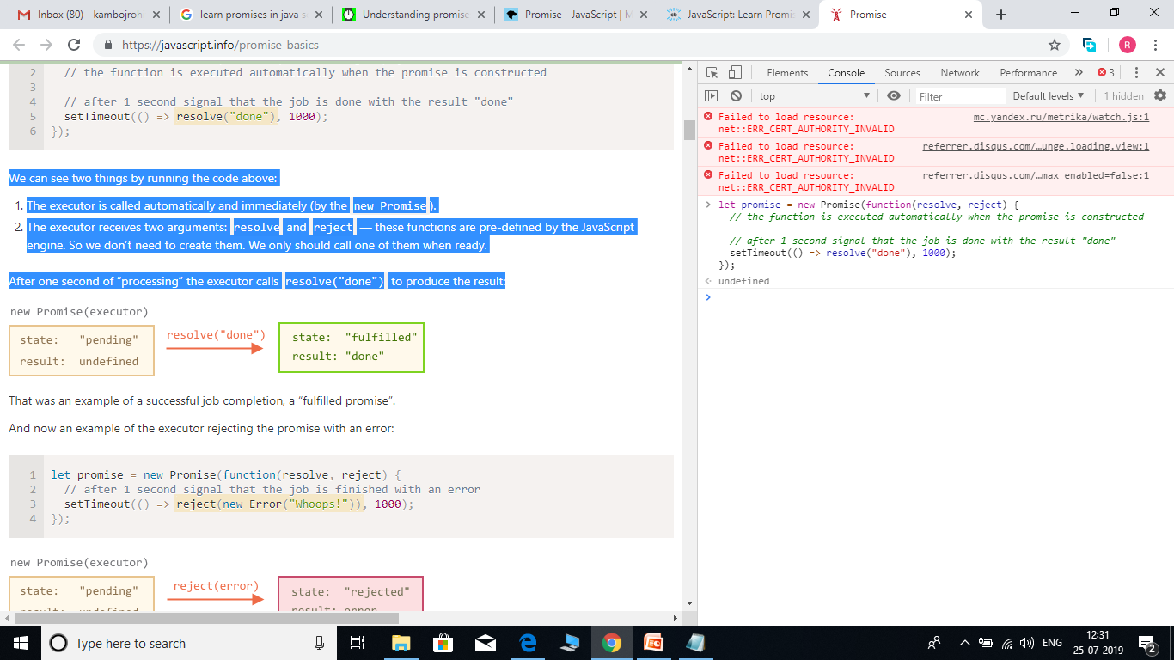
We can see two things by running the code above:
The executor is called automatically and immediately (by the new Promise).
The executor receives two arguments: resolve and reject — these functions are pre-defined by the JavaScript engine. So we don’t need to create them. We only should call one of them when ready.
After one second of “processing” the executor calls resolve("done") to produce the result:

Slide 14
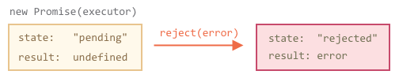
That was an example of a successful job completion, a “fulfilled promise”.
And now an example of the executor rejecting the promise with an error:
let promise = new Promise(function(resolve, reject) {
// after 1 second signal that the job is finished with an error
setTimeout(() => reject(new Error("Whoops!")), 1000);
});
To summarize, the executor should do a job (something that takes time usually) and then call resolve or reject to change the state of the corresponding Promise object.

Slide 15
The Promise that is either resolved or rejected is called “settled”, as opposed to a initially “pending” Promise.
There can be only a single result or an error -
The executor should call only one resolve or one reject. The promise’s state change is final.
All further calls of resolve and reject are ignored:-
let promise = new Promise(function(resolve, reject) {
resolve("done");
reject(new Error("…")); // ignored
setTimeout(() => resolve("…")); // ignored
});
The idea is that a job done by the executor may have only one result or an error.
Also, resolve/reject expect only one argument (or none) and will ignore additional arguments.

Slide 16
Reject with Error objects
In case something goes wrong, we can call reject with any type of argument (just like resolve). But it is recommended to use Error objects (or objects that inherit from Error).
Immediately calling resolve/reject
In practice, an executor usually does something asynchronously and calls resolve/reject after some time, but it doesn’t have to. We also can call resolve or reject immediately, like this:
let promise = new Promise(function(resolve, reject) {
// not taking our time to do the job
resolve(123); // immediately give the result: 123
});
The state and result are internal
The properties state and result of the Promise object are internal. We can’t directly access them from our “consuming code”. We can use the methods .then/.catch/.finally for that. They are described below.

Slide 17
Consumers: then, catch, finally
A Promise object serves as a link between the executor and the consuming functions , which will receive the result or error. Consuming functions can be registered (subscribed) using methods .then, .catch and .finally.
Then -
The most important, fundamental one is .then.
The syntax is:-
promise.then(
function(result) { /* handle a successful result */ },
function(error) { /* handle an error */ }
);

Slide 18
The first argument of .then is a function that: runs when the promise is resolved, and receives the result.
The second argument of .then is a function that: runs when the promise is rejected, and receives the error.
For instance, here’s a reaction to a successfully resolved promise:-
let promise = new Promise(function(resolve, reject) {
setTimeout(() => resolve("done!"), 1000);
});
// resolve runs the first function in .then
promise.then(
result => alert(result), // shows "done!" after 1 second
error => alert(error) // doesn't run
);
Or – function(result){alert(result)},
function(error){alert(error)});

Slide 19
The first function was executed.
And in the case of a rejection – the second one:-
let promise = new Promise(function(resolve, reject) {
setTimeout(() => reject(new Error("Whoops!")), 1000);
});
// reject runs the second function in .then
promise.then(
result => alert(result), // doesn't run
error => alert(error) // shows "Error: Whoops!" after 1 second
);
If we’re interested only in successful completions, then we can provide only one function argument to .then:-

Slide 20
let promise = new Promise(resolve => {
setTimeout(() => resolve("done!"), 1000);
});
promise.then(alert); // shows "done!" after 1 second
Catch -
If we’re interested only in errors, then we can use null as the first argument: .then(null, errorHandlingFunction). Or we can use .catch(errorHandlingFunction), which is exactly the same:-
let promise = new Promise((resolve, reject) => {
setTimeout(() => reject(new Error("Whoops!")), 1000);
});
// .catch(f) is the same as promise.then(null, f)
promise.catch(alert); // shows "Error: Whoops!" after 1 second
The call .catch(f) is a complete analog of .then(null, f), it’s just a shorthand.

Slide 21
Finally -
Just like there’s a finally clause in a regular try {...} catch {...}, there’s finally in promises.
The call .finally(f) is similar to .then(f, f) in the sense that it always runs when the promise is settled: be it resolve or reject.
finally is a good handler for performing cleanup, e.g. stopping our loading indicators, as they are not needed anymore, no matter what the outcome is.
Like this: -
new Promise((resolve, reject) => {
/* do something that takes time, and then call resolve/reject */
})
// runs when the promise is settled, doesn't matter successfully or not
.finally(() => stop loading indicator)
.then(result => show result, err => show error)

Slide 22
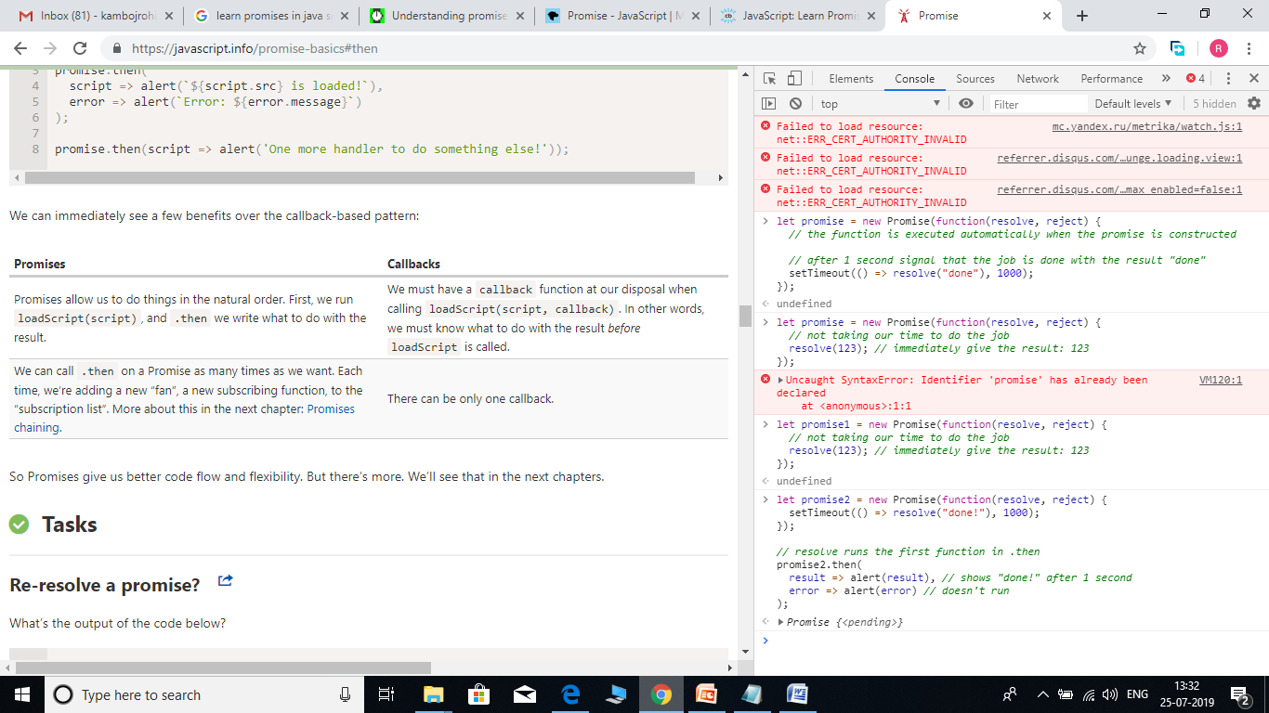

Slide 23
Promises chaining
We have a sequence of asynchronous tasks to be done one after another. For instance, loading scripts. How can we code it well?
Promises provide a couple of recipes to do that - promise chaining.
It looks like this:-

Slide 24
new Promise(function(resolve, reject) {
setTimeout(() => resolve(1), 1000); // (*)
}).then(function(result) { // (**)
alert(result); // 1
return result * 2;
}).then(function(result) { // (***)
alert(result); // 2
return result * 2;
}).then(function(result) {
alert(result); // 4
return result * 2;
});

Slide 25
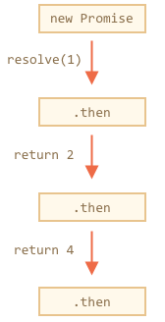
The idea is that the result is passed through the chain of .then handlers.
Here the flow is:
The initial promise resolves in 1 second (*),
Then the .then handler is called (**).
The value that it returns is passed to the next .then handler (***)
…and so on.
As the result is passed along the chain of handlers, we can see a sequence of alert calls: 1 → 2 → 4.

Slide 26
The whole thing works, because a call to promise.then returns a promise, so that we can call the next .then on it.
When a handler returns a value, it becomes the result of that promise, so the next .then is called with it.
To make these words more clear, here’s the start of the chain:
new Promise(function(resolve, reject) {
setTimeout(() => resolve(1), 1000);
}).then(function(result) {
alert(result);
return result * 2; // <-- (1)
}) // <-- (2)
// .then…
The value returned by .then is a promise, that’s why we are able to add another .then at (2). When the value is returned in (1), that promise becomes resolved, so the next handler runs with the value.

Slide 27
A classic newbie error: technically we can also add many .then to a single promise. This is not chaining.
For example:
let promise = new Promise(function(resolve, reject) {
setTimeout(() => resolve(1), 1000);
});
promise.then(function(result) {
alert(result); // 1
return result * 2;
});
promise.then(function(result) {
alert(result); // 1
return result * 2;
});
promise.then(function(result) {
alert(result); // 1
return result * 2;
});

Slide 28
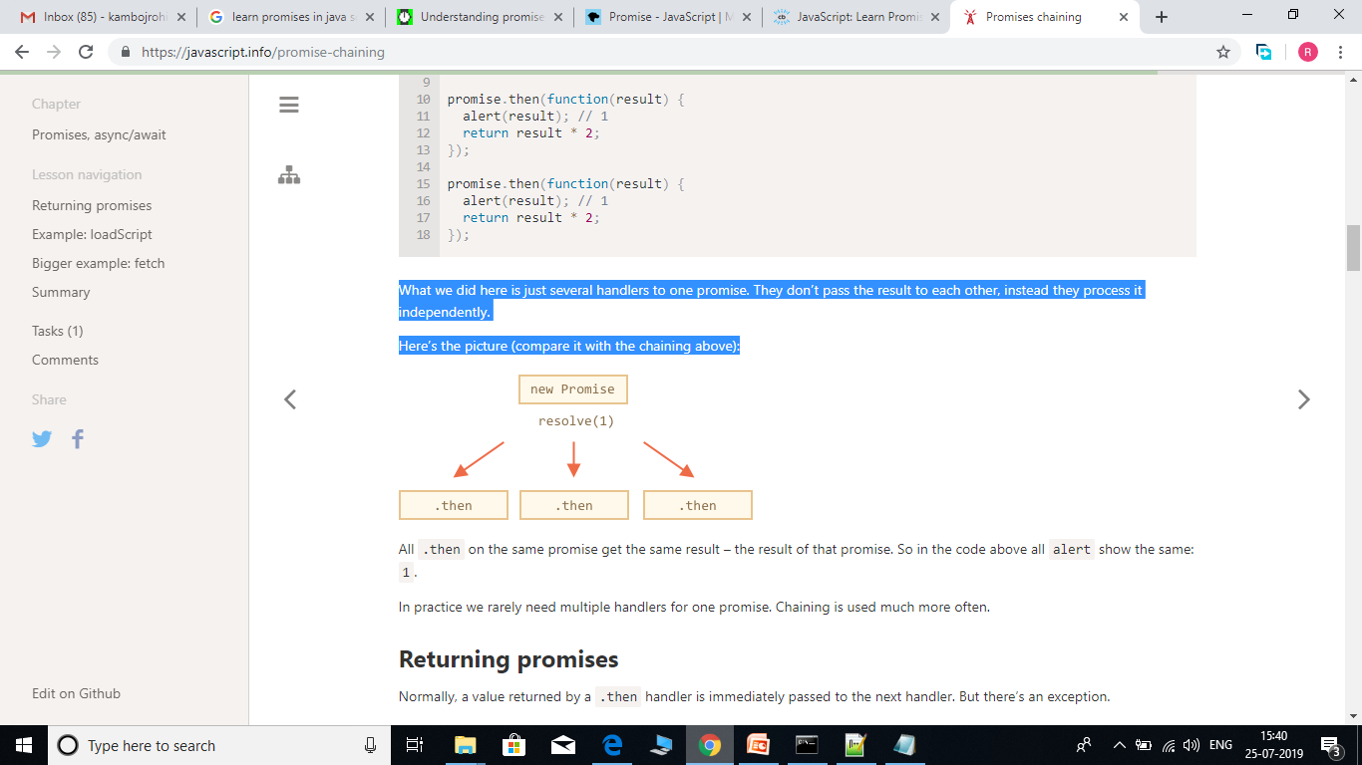
What we did here is just several handlers to one promise. They don’t pass the result to each other, instead they process it independently.
Here’s the picture (compare it with the chaining above):
All .then on the same promise get the same result – the result of that promise. So in the code above all alert show the same: 1.
In practice we rarely need multiple handlers for one promise. Chaining is used much more often.

Slide 29
Returning promises
Normally, a value returned by a .then handler is immediately passed to the next handler. But there’s an exception.
If the returned value is a promise, then the further execution is suspended until it settles. After that, the result of that promise is given to the next .then handler.
For instance:

Slide 30
new Promise(function(resolve, reject) {
setTimeout(() => resolve(1), 1000);
}).then(function(result) {
alert(result); // 1
return new Promise((resolve, reject) => { // (*)
setTimeout(() => resolve(result * 2), 1000);
});
}).then(function(result) { // (**)
alert(result); // 2
return new Promise((resolve, reject) => {
setTimeout(() => resolve(result * 2), 1000);
});
}).then(function(result) {
alert(result); // 4
});

Slide 31
Here the first .then shows 1 and returns new Promise(…) in the line (*). After one second it resolves, and the result (the argument of resolve, here it’s result*2) is passed on to handler of the second .then in the line (**). It shows 2 and does the same thing.
So the output is again 1 → 2 → 4, but now with 1 second delay between alert calls.
Returning promises allows us to build chains of asynchronous actions.

Slide 32
Async/await
There’s a special syntax to work with promises in a more comfortable fashion, called “async/await”. It’s surprisingly easy to understand and use.
Async functions -
Let’s start with the async keyword. It can be placed before a function, like this:
async function f() {
return 1;
}
The word “async” before a function means one simple thing: a function always returns a promise. Even If a function actually returns a non-promise value, prepending the function definition with the “async” keyword directs JavaScript to automatically wrap that value in a resolved promise.

Slide 33
For instance, the code above returns a resolved promise with the result of 1, let’s test it:-
async function f() {
return 1;
}
f().then(alert); // 1
We could explicitly return a promise, that would be the same as:-
async function f() {
return Promise.resolve(1);
}
f().then(alert); // 1

Slide 34
So, async ensures that the function returns a promise, and wraps non-promises in it. Simple enough, right? But not only that. There’s another keyword, await, that works only inside async functions, and it’s pretty cool.
Await -
The syntax:-
// works only inside async functions
let value = await promise;
The keyword await makes JavaScript wait until that promise settles and returns its result.
Here’s an example with a promise that resolves in 1 second:

Slide 35
async function f() {
let promise = new Promise((resolve, reject) => {
setTimeout(() => resolve("done!"), 1000)
});
let result = await promise; // wait till the promise resolves (*)
alert(result); // "done!"
}
f();

Slide 36
The function execution “pauses” at the line (*) and resumes when the promise settles, with result becoming its result. So the code above shows “done!” in one second.
Let’s emphasize: await literally makes JavaScript wait until the promise settles, and then go on with the result. That doesn’t cost any CPU resources, because the engine can do other jobs meanwhile: execute other scripts, handle events etc.
It’s just a more elegant syntax of getting the promise result than promise.then, easier to read and write.

Slide 37
Can’t use await in regular functions
If we try to use await in non-async function, there would be a syntax error:
function f() {
let promise = Promise.resolve(1);
let result = await promise; // Syntax error
}
We will get this error if we do not put async before a function. As said, await only works inside an async function.

